Slide 1




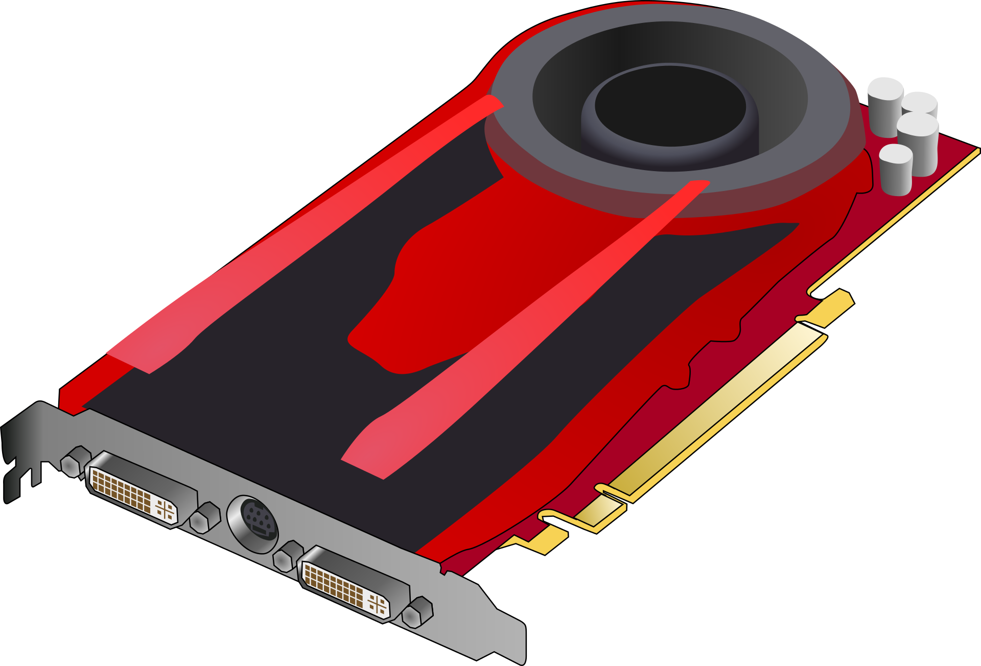
General Purpose Operating System (GPOS)
Task scheduling
Device drivers
Task 1
Resource management
Read/Write
File 1

Slide 2


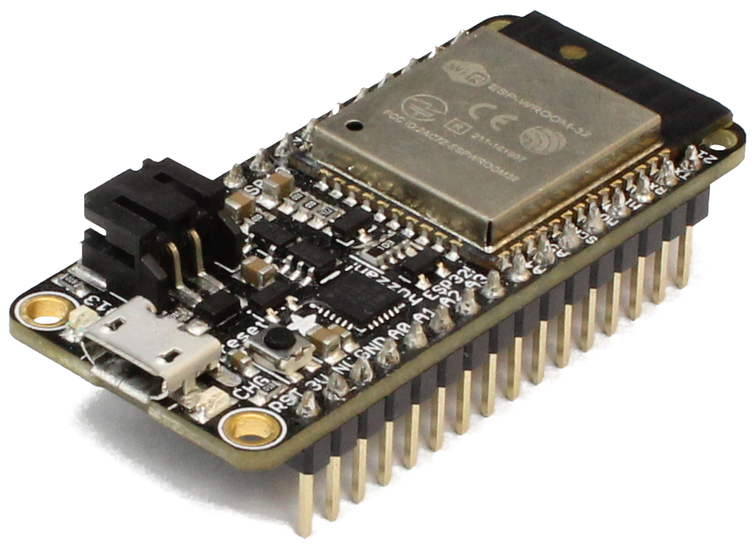



Real-Time Operating System (RTOS)
Task scheduling
Device drivers
Task 1
Resource management
Read/Write
File 1

Slide 3
Super Loop
Entry Point (main())
Setup
Task 1
Interrupt Service Routine (ISR)
Loop
Task 2
Task 3

Slide 4
RTOS
Task: set of program instructions loaded in memory
Thread: unit of CPU utilization with its own program counter and stack
Process: instance of a computer program
Entry Point (main())
Setup
Interrupt Service Routine (ISR)
FreeRTOS: Task = Thread
Task 1
Task 2
Task 3

Slide 5
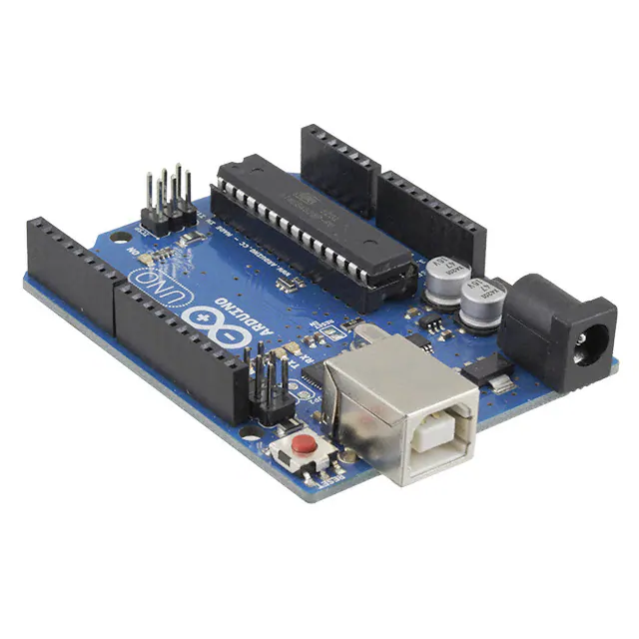
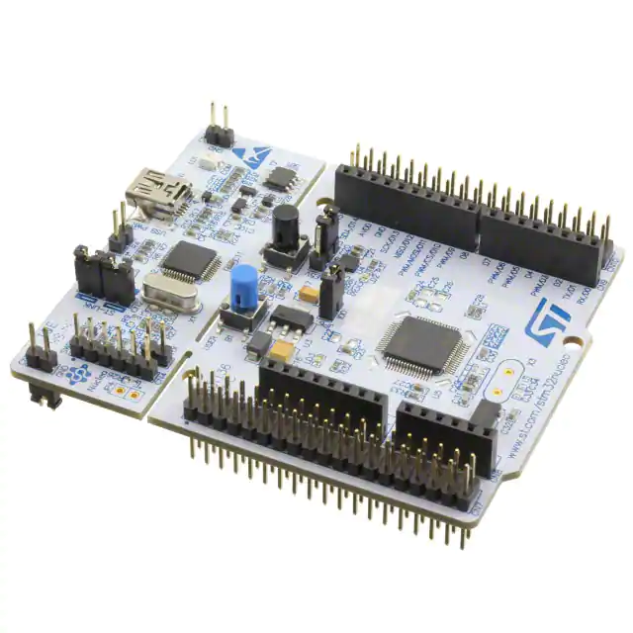
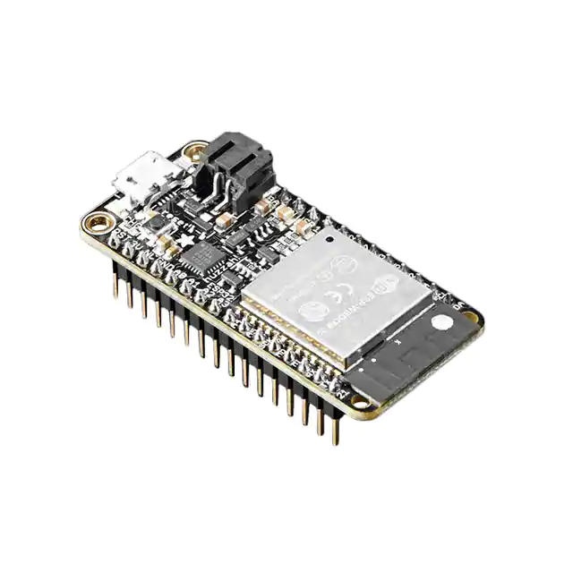
ATmega 328p
16 MHz
32 kB flash
2 kB RAM
STM32L476RG
80 MHz
1 MB flash
128 kB RAM
ESP-WROOM-32
240 MHz (dual core)
4 MB flash
520 kB RAM
Super Loop
RTOS

Slide 6
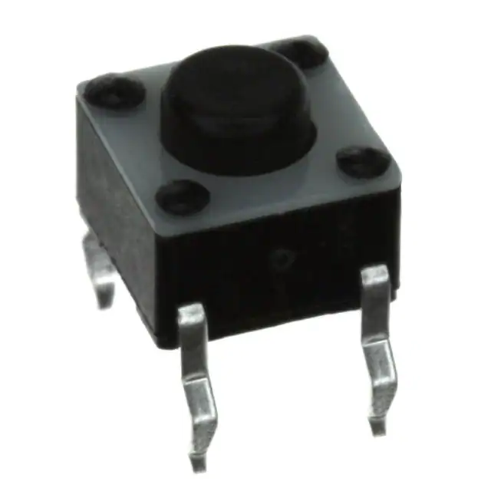
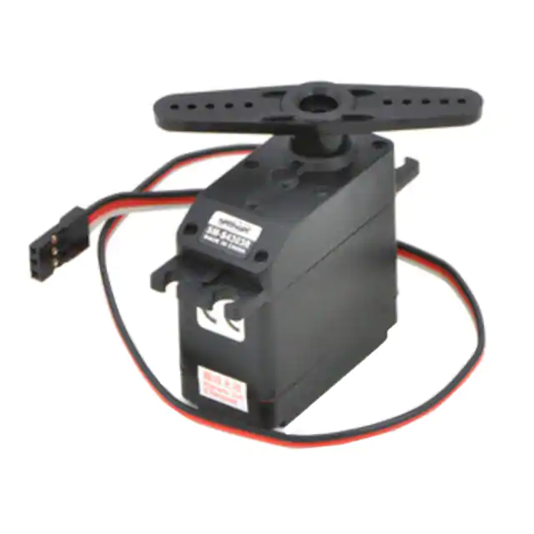
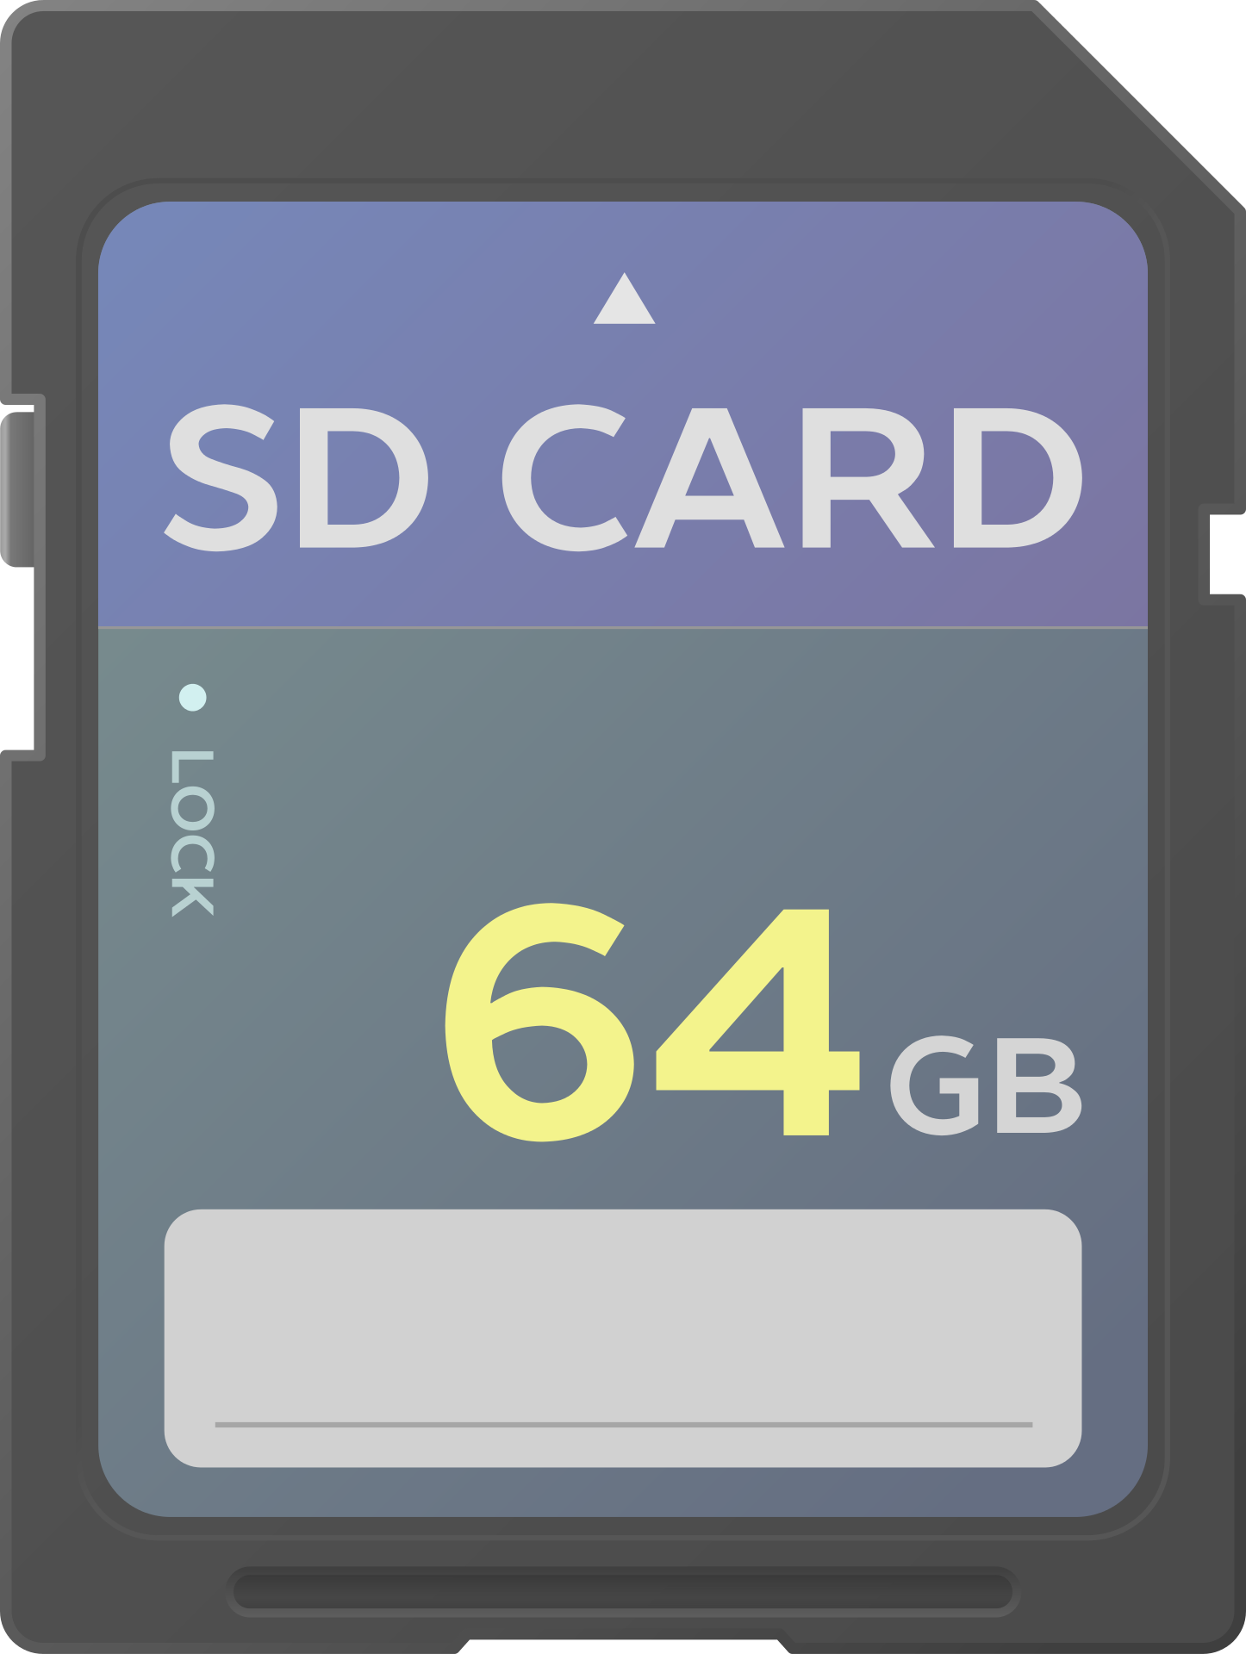

Slide 7


Slide 8
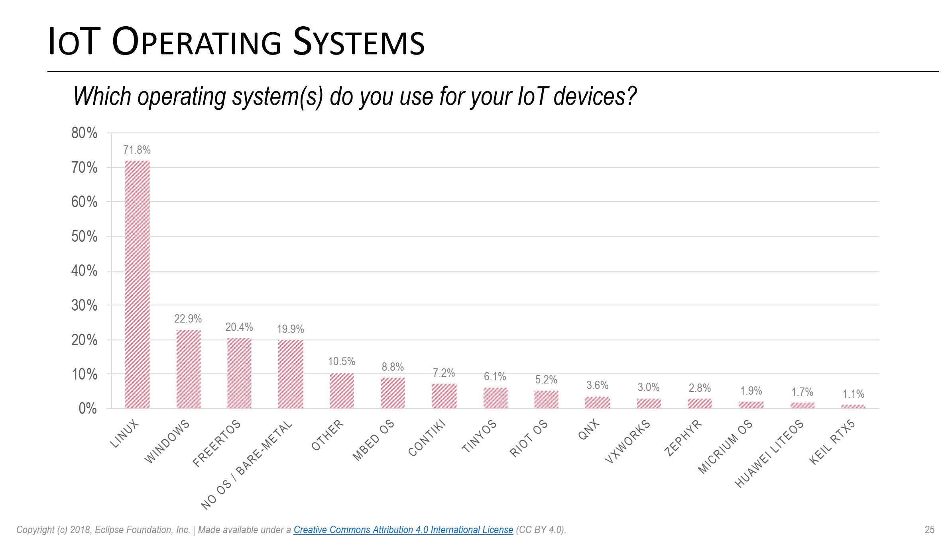

Slide 9
